Slide 1
Abnormality of Hair Shaft
Dr. Mehdi Amirnia
professor of Dermatology,
Tabriz University of Medical Sciences, Iran

Slide 2
Structural defects with increased fragility

Slide 3
Monilethrix
(beading of hair)
Etiology: AD, hereditary nature
Pathology:
hair shaft beaded, break easily
Elliptical Nodes (0.7-1 mm)
Separated by narrower internodes
Electron Microscopy:
  Node: Normal
  Internode: longitudinal ridge
  Follicle: wide and narrow zone corresponding to the node and internode
Complete nodal complex was found in 24h.
Intermittent Ant. Mitotic agent like lesion

Slide 4
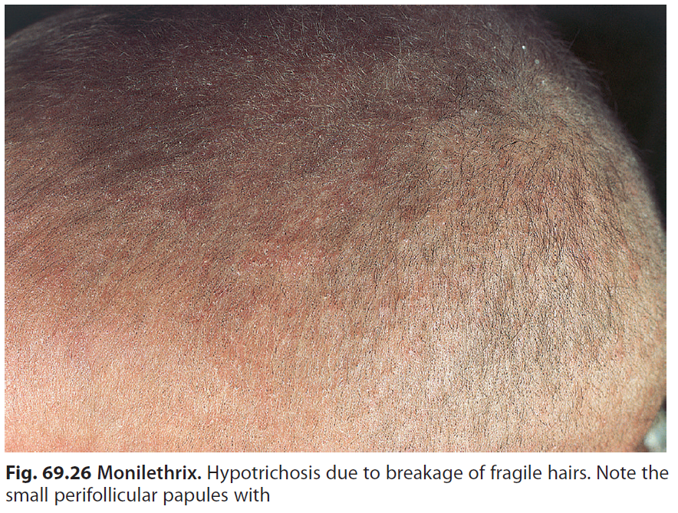
Clinical Features:
At birth: Normal
Start: First Months
Fragile beaded hair
Follicular keratosis in nape and occiput (even total hair of body)
Life long
Spontaneous improvement (occasionally)
Pregnancy and griseoufulivin Temporary improvement

Slide 5
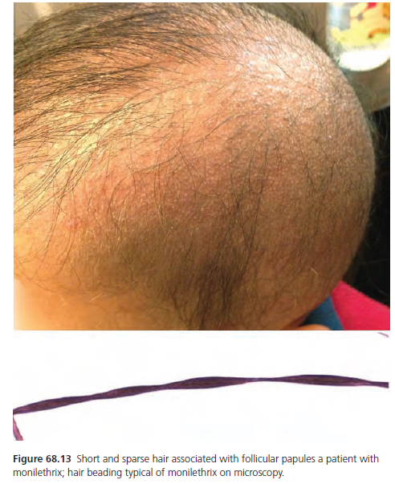

Slide 6
Treatment
None
Oral retinoid (some hair regrowth)
Reduction of hair dressing trauma

Slide 7
Pili torti
(twisting of hair)
Flat hair + irregular intervals completely rotate through 180° around long axis.
Associated disease:
  Menkes syndrome (copper defect)
  Björnstad syndrome (deafness)
  Bazex syndrome (B.C.C)
  Ectodermal dysplasia

Slide 8
Etiology
AD
Local inflammatory process (around ciratrical A.)
Acquired pili torti  retinoid

Slide 9
Clinical M.
Normal at birth
3 months (start)
Brittle hair + break 5 cm at length
Totally (short+ course+ stubble whole scalp)
Spangled appearance in reflected light
Occasionally: nail defect, keratosis pilaris, dental defect, MR

Slide 10
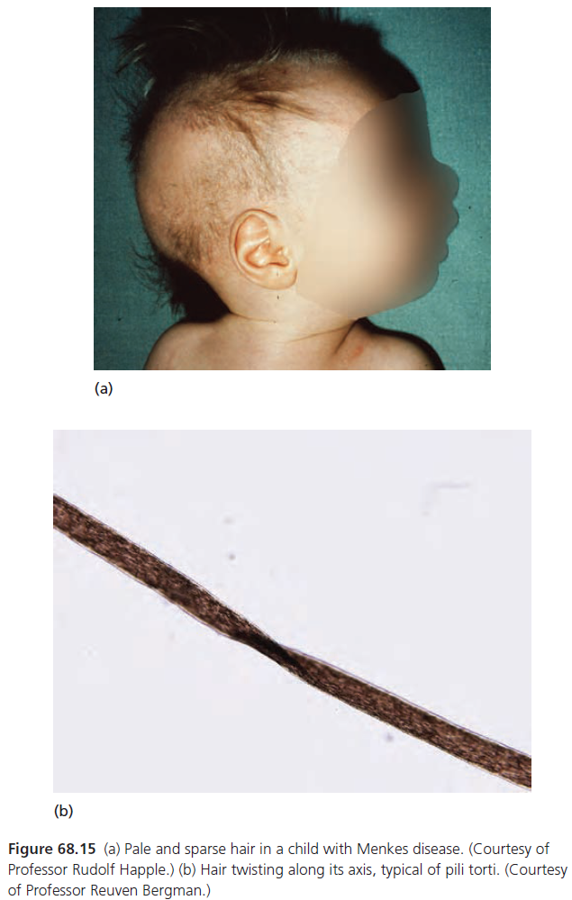

Slide 11
Netherton Syndrome
(bamboo hair)
Bamboo like nodes in fragile hair
Girls
Ichthyosis linearis circumflex (most common) or ichthyosis vulgaris or I. erythroderma
Accompany: Trichorrhexis invaginata , Trichorrhexis Nodosa

Slide 12
Clinical M.
Primarily cutaneous change+ sparse and fragile hair
Generalized scaling and erythema at birth
AD +
Hair: Short- dry- lusterless-brittle
Node: extorted cuticle cell
Sparse eyebrow and lashes (or absence)
Na⁺ 
Treatment:
None-(response PUVA)

Slide 13
Trichorrhexis nodosa
Most common response of hair shaft to injury
Coticular cells  disrupted
Dry- brittle hair- 1 to 5 nodules
associated disorders:
Monilithix- pili Annulati- Netherton Syn.
Treatment:
avoid chemical and physical trauma

Slide 14
Trichothiodystrophy
Brittle hair + low Sulphur content
BIDS (Brittle hair+ Intellectual impairment+ Decreased fertility + Short stature)
PIBIDS (all of them + photosensitivity +ichthyosis)

Slide 15
Pathology
Trichoschisis (break cleanly)
Flattened
Alternative bright and dark zone
Low Sulphur + low cysteine

Slide 16
Clinical M.
Sparse
Short
Brittle
Degree of Alopecia
Lamellar Ichthyosis

Slide 17
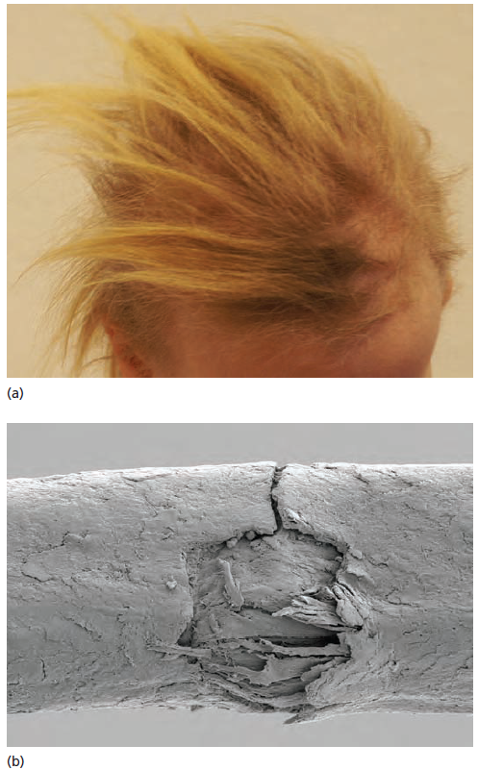
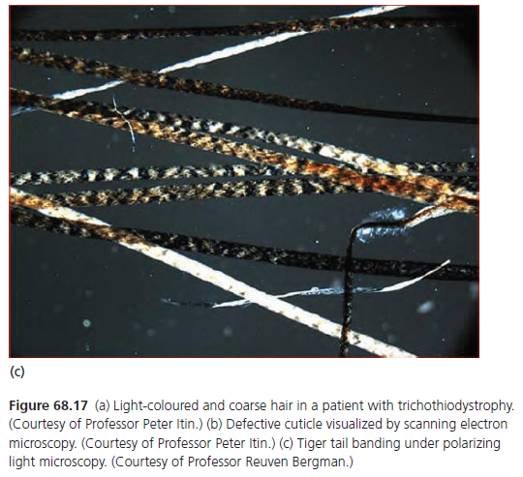

Slide 18
Structural defect without increased Fragility

Slide 19
Pili Annulati
(ringed hair)
Alternative light and dark bands along their length (sandy App. )
Associated: Blue Nevuse
Bright app. In reflected light Due to air space in the cortex

Slide 20
Clinical M.
Short hair
Sandy app. Of the shafts in light reflect
Axillary hair  involve
Prognosis  good

Slide 21
Woolly hair
Tightly curled hair
Four type: hereditary- familial- symmetrical circumscribed- woolly hair nevus)
Finer hair
Absence of cuticle
Trichorrhexis nodosa (Assocciated)
At birth
Circumscribed area of scalp is tightly curled
Paler hair
Epidermal Nevus +(not same site)

Slide 22
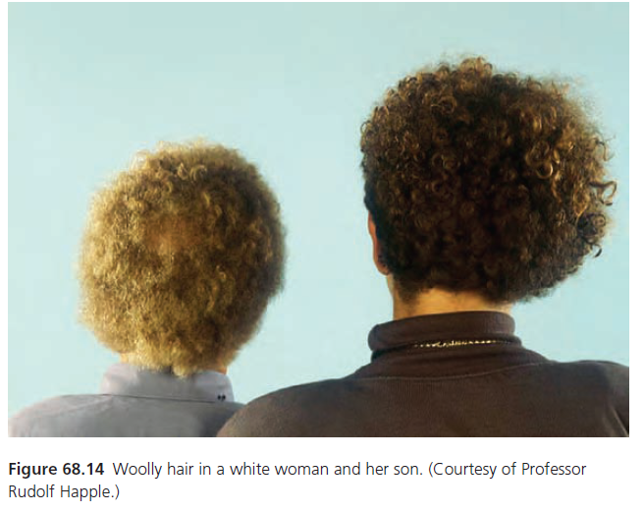

Slide 23
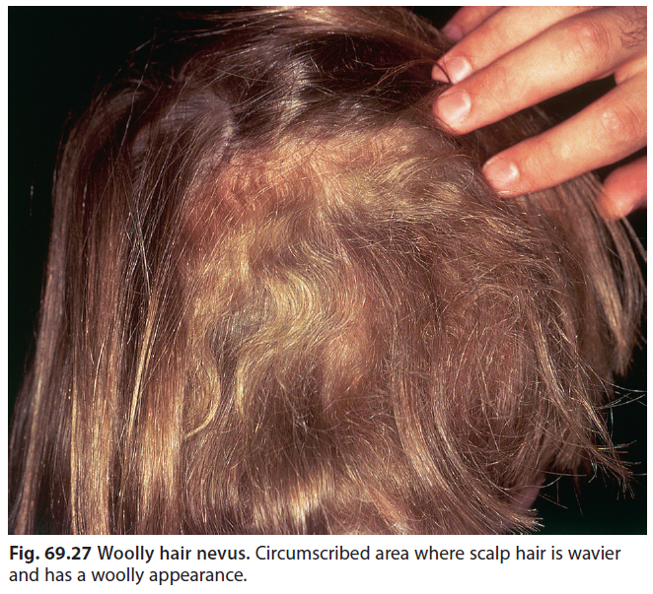

Slide 24
Acquired progressive kinking of the hair
Onset in adolescence
Finer or course hair+ dry+ lusterless
Anagen duration is reduced
Gradually kinking in one region of the scalp
No sharp line of involved and uninvolved
Some Pt.: progress to male baldness

Slide 25
Uncombable hair syndrome
(pili triangular)
Triangular configuration of the shaft
Well defined longitudinal depression
Start 3 months – 12 years
Normal length and volume + silvery color
Resist all effort to brush or comb
Treatment: Biotin

Slide 26
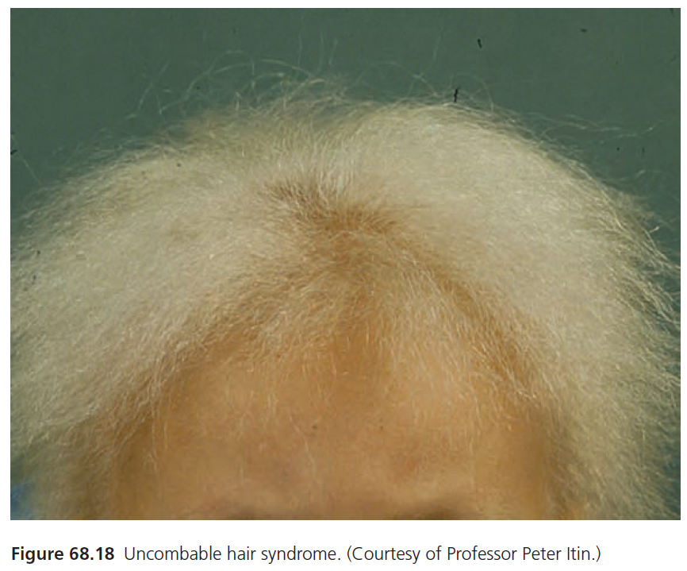

Slide 27
Other abnormality

Slide 28
Trichoclasis
Common
Greensticle fracture of the hair shaft
Intact cuticle
Sulphur

Slide 29
Trichoptilosis
Longitudinal spliting (two or several division)
Commonest macroscopic response of the hair shaft to chemical and physical trauma
Etiology:
  Vigorous brushing
  Long hair
  Any congenital brittle hair
  Node of the pili torti

Slide 30
Clinical:
  Women with dry and brittle hair
  Associated with T. Nodosa and trichocloss
Occasional:
  Central trichoptilosis (tip not involve)

Slide 31
Pili multigemini
Multiple papilla form hairs emerge through a single pilosebaceous canal
2-8 matrices and papilla
Face (along the line of Jaw)
Recurrent inflammatory nodules
Leave scar
Treatment:
  If plucked they regrow

Slide 32
Weathering of the hair shaft
Structural change in the hair shaft due to cosmetic procedures
Combing- brushing- bleaching- permanent waving
Trichorrhexis nodosa in the severest form of weathering

Slide 33
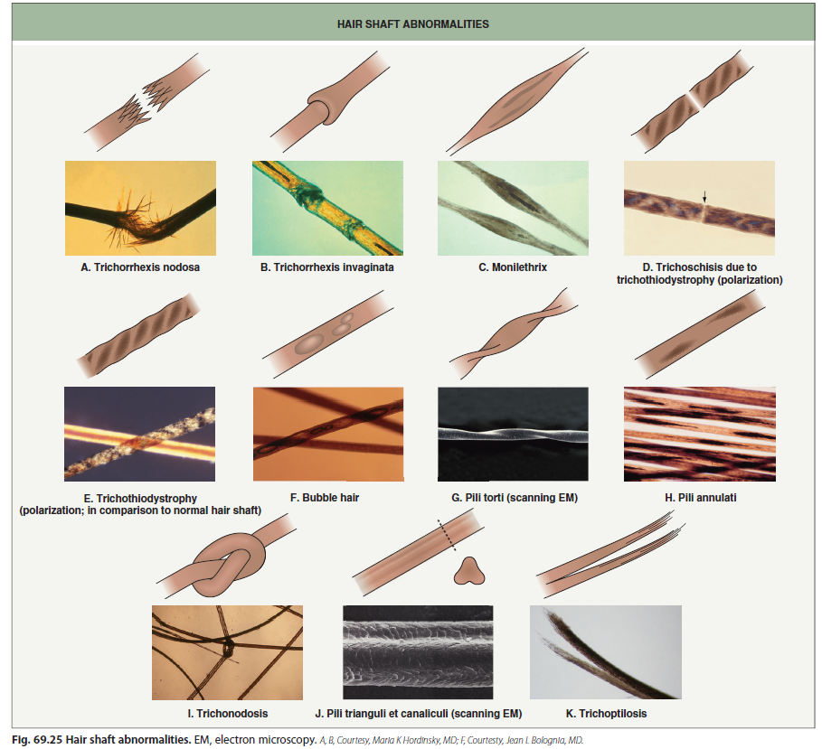

Slide 34
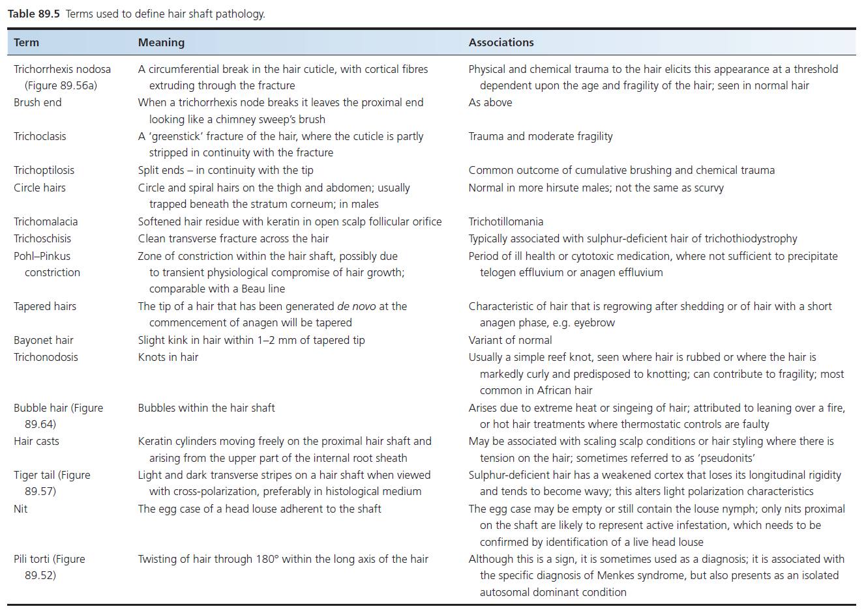

Slide 35

Thanks

